Slide 1
Chapter 5: RTL Coding Guidelines
Reuse Methodology Manual for System-On-Chip Designs
Notes:
This is the light cover slide option.

Slide 2
Chapter content
Basic Coding Practices.
Coding for Portability.
Guidelines for Clocks and Resets.
Coding for Synthesis.
Partitioning for Synthesis.
Designing with Memories.
Code Profiling.

Slide 3
5.2 Basic Coding Practices
5.2.1 General Naming Conventions
Rule – Develop a naming convention for the design. Document it and use it consistently throughout the design.
Guideline – Use lowercase letters for all signal names, variable names, and port names.
Guideline – Use uppercase letters for names of constants and user-defined types.
Guideline –Use meaningful names for signals, ports, functions, and parameters. For example, do not use ra for a RAM address bus. Instead, use ram_addr.
Guideline – If your design uses several parameters, use short but descriptive names. During elaboration, the synthesis tool concatenates the module’s name, parameter names, and parameter values to form the design unit name. Thus, lengthy parameter names can cause excessively long design unit names when you elaborate the design with synthesis tools.

Slide 4
5.2 Basic Coding Practices
Guideline – Use a consistent name for the clock signal, such as clk. If there is more than one clock in the design, use clk as the prefix for all clock signals (for example, clkl, clk2, or clk_interface).
Guideline – Use the same name for all clock signals that are driven from the same source.
Guideline – For active-low signals, end the signal name with an underscore followed by a lowercase character (for example, _b or _n).Use the same lowercase character consistently to indicate active-low signals throughout the design.
Guideline – Use a consistent name for reset signals, such as rst. If the reset signal is active low, use a name like rst_n (or substitute n with whatever lowercase character you are using to indicate active-low signals).

Slide 5
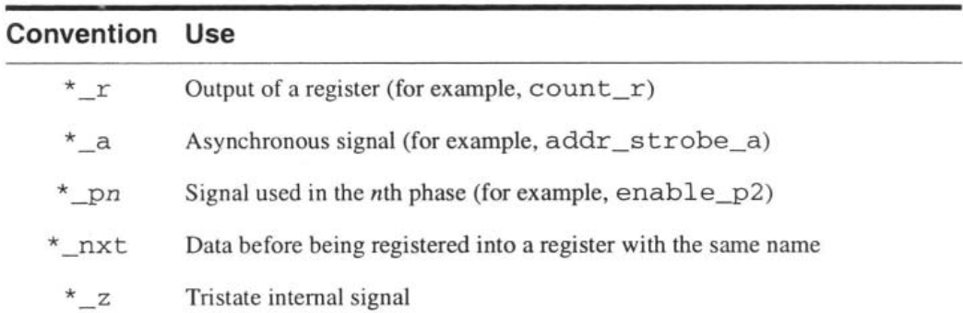
5.2 Basic Coding Practices
5.2.1 General Naming Conventions
Rule – When describing multibit buses, use a consistent ordering of bits. For VHDL, use either (x downto 0) or (0 to x). For Verilog, use [x:0] or [0:x]. Using a consistent ordering helps improve the readability of the code and reduces the chance of accidently swapping order between connected buses.
Guideline – Use[x:0]for multibit signals in Verilog and (x downto 0) for multibit signals in VHDL. We make this recommendation to establish a standard, and thus achieve some consistency across multiple designs and design teams.
Guideline – When possible, use the same name or similar names for ports and signals that are connected (for example, a => a; or a => a_int;).

Slide 6
5.2 Basic Coding Practices
5.2.3 State Variable Names
Rule – Use a distinctive suffix for state variable names. Recommended names are <name>_cs for the current state, and <name>_ns for the next state.
5.2.4 Include Informational Headers in Source Files
Rule – Include a commented, informational header at the top of every source file, including scripts. The header must contain:
Legal statement: confidentiality, copyright, restrictions on reproduction.
Filename.
Author.
Description of function and list of key features of the module.
Date the file was created.
Modification history including date, name of modifier, and description of the change.

Slide 7
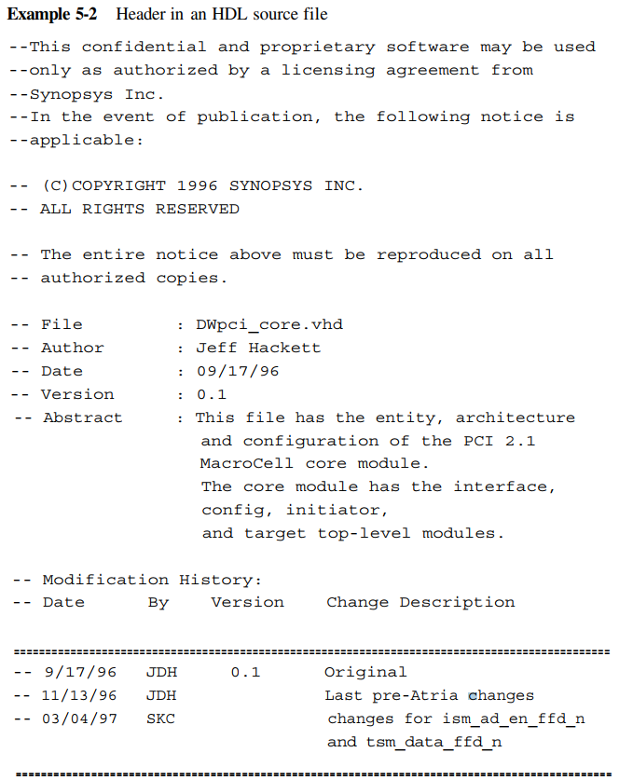
5.2 Basic Coding Practices

Slide 8
5.2 Basic Coding Practices
5.2.5 Use Comments
Rule – Use comments appropriately to explain processes, functions, and declarations of types and subtypes.
Comments should be placed logically, near the code that they describe.
Comments should be brief, concise, and explanatory.
Avoid “comment clutter”; obvious functionality does not need to be commented.
5.2.6 Keep Commands on Separate Lines
Rule – Use a separate line for each HDL statement. Although both VHDL and Verilog allow more than one statement per line, the code is more readable and maintainable if each statement or command is on a separate line.
5.2.7 Line Length Guideline – Keep the line length to 72 characters or less.

Slide 9
5.2 Basic Coding Practices
5.2.8 Indentation Rule – Use indentation to improve the readability of continued code lines and nested loops.
Guideline – Use indentation of 2 spaces. Larger indentation (for example, 8 spaces) restricts line length when there are several levels of nesting.
Guideline – Avoid using tabs. Differences in editors and user setups make the positioning of tabs unpredictable and can corrupt the intended indentation. There are programs available, including language-specific versions of emacs, that will replace tabs with spaces.

Slide 10
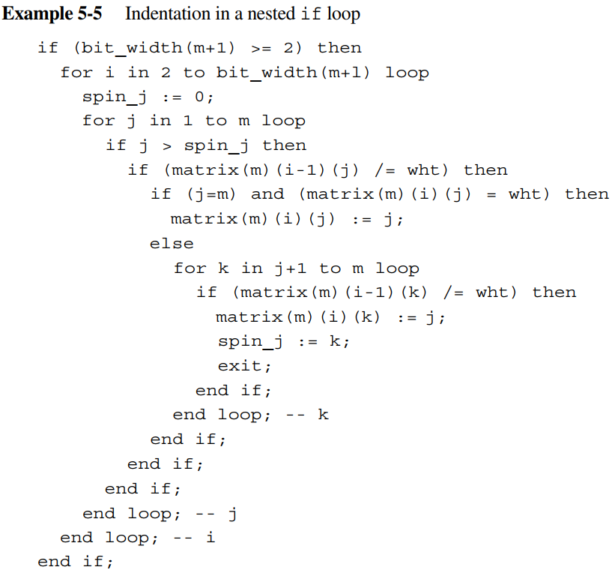
5.2 Basic Coding Practices

Slide 11
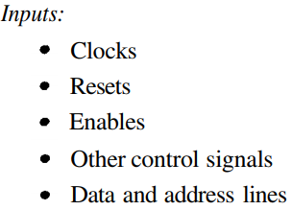
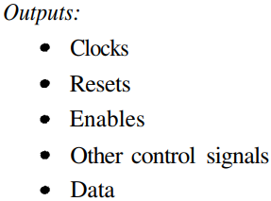
5.2 Basic Coding Practices
5.2.9 Do Not Use HDL Reserved Words
Rule – Do not use VHDL or Verilog reserved words for names of any elements in your RTL source files. Because macro designs must be translatable from VHDL to Verilog and from Verilog to VHDL, it is important not to use VHDL reserved words in Verilog code, and not to use Verilog reserved words in VHDL code.
5.2.10 Port Ordering
Rule– Declare ports in a logical order, and keep this order consistent throughout the design.
Guideline – Declare one port per line, with a comment following it (preferably on the same line).
Guideline – For each interface, declare the ports in the following order:

Slide 12
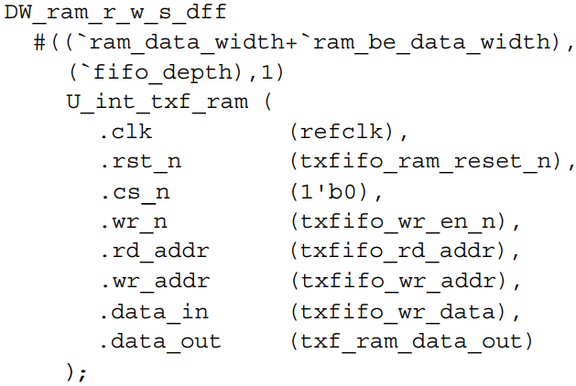
5.2 Basic Coding Practices
5.2.11 Port Maps and Generic Maps
Rule – Always use explicit mapping for ports and generics, using named association rather than positional association.

Slide 13
5.2 Basic Coding Practices
5.2.13 Use Functions
Guideline – Use functions, when possible, instead of repeating the same sections of code. If possible, generalize the function to make it reusable.
5.2.14 Use Loops and Arrays
Guideline – Use loops and arrays for improved readability of the source code. For example, describing a shift register, PN-sequence generator, or Johnson counter with a loop construct can greatly reduce the number of lines of source code while still retaining excellent readability.

Slide 14
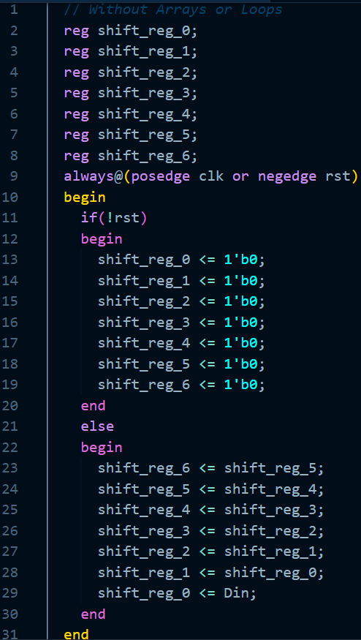
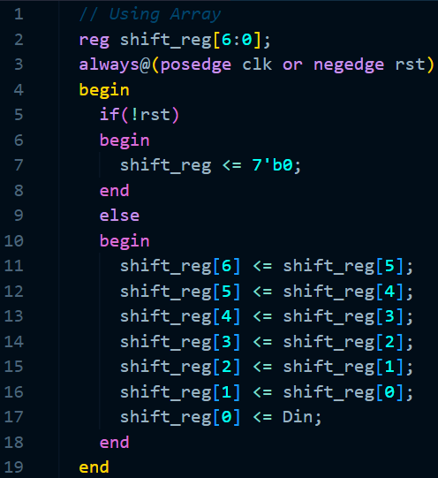
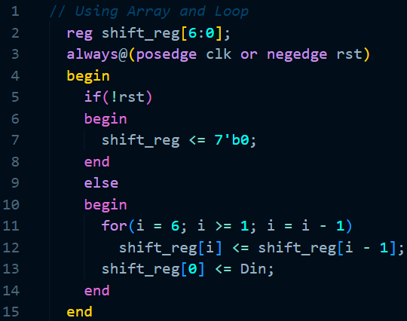
5.2 Basic Coding Practices

Slide 15
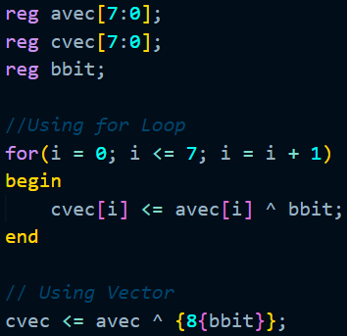
5.2 Basic Coding Practices
Guideline – Arrays are significantly faster to simulate than for loops. To improve simulation performance, use vector operations on arrays rather than for loops whenever possible.

Slide 16
5.2 Basic Coding Practices
5.2.15 Use Meaningful Labels
Rule – Label each process block with a meaningful name. This is very helpful for debug. For example, you can set a breakpoint by referencing the process label.
Guideline – Label each process block <name>_PROC.
Rule – Label each instance with a meaningful name.
Guideline – Label each instance U_<name>.

Slide 17
5.3 Coding for Portability
5.3.2 Do Not Use Hard-Coded Numeric Values
Guideline – Use constants instead of hard-coded numeric values.
Using constants has the following advantages:
Constants are more intelligible as they associate a design intention with the value.
Constant values can be changed in one place.
Compilers can spot typos in constants but not in hard-coded values. For example, if MY_BUS_LENGTH is misspelled MY_BUS_LEGTH, the error will be flagged; however, if the intended value 0x100001 is given as 0x10001, the error will not be caught.

Slide 18
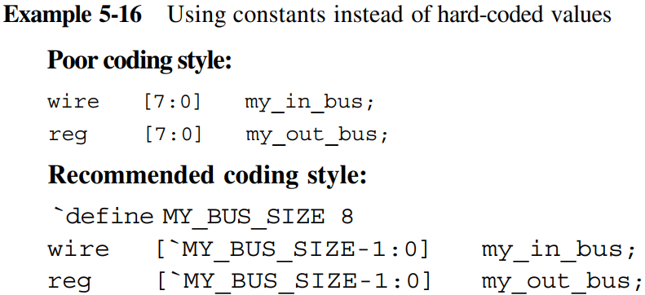
5.3 Coding for Portability

Slide 19
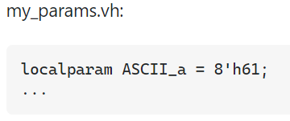
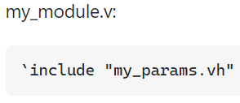
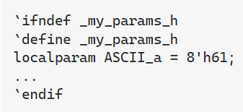
5.3 Coding for Portability
5.3.4 Constant Definition Files
Guideline – Keep constant and parameter definitions in one or a small number of files with names such as DesignName_constants.v or DesignName_parameters.v
Source files should not make references to constant definition files with the include statement, since this will cause problems if the core is instantiated multiple times in the design, but with different constant values. We recommend that constant definition files be specified only on tool command lines.

Slide 20
5.3 Coding for Portability
5.3.5 Avoid Embedding Synthesis Commands
Although it is possible to embed synthesis commands directly in the source code, this practice is not recommended. Others who synthesize the code may not be aware of the hidden commands, which may cause their synthesis scripts to produce poor results. If the design is reused in a new application, the synthesis goals may be different, such as a higher-speed version
5.3.6 Use Technology-Independent Libraries
Guideline – For arithmetic components, use the DesignWare Foundation Library.
Guideline – Avoid instantiating gates in the design. Gate-level designs are very hard to read, and thus difficult to maintain and reuse. If technology-specific gates are used, then the design is not portable to other technologies.
Guideline – If you must use technology-specific gates, then isolate these gates in a separate module. This will make it easier to modify these gates as needed for different technologies.
Guideline – If you must instantiate a gate, use the Synopsys generic technology library, GTECH.

Slide 21
5.4 Guidelines for Clocks and Resets
5.4.1 Avoid Mixed Clock Edges
Guideline – Avoid using both positive-edge and negative-edge triggered flip-flops in your design.
Clocking on both edges creates several problems:
1) Timing closure becomes challenging.
2) Most scan-based testing methodologies require separate handling of positive and negative-edge triggered flops.
Rule – If you must use both positive-edge and negative-edge triggered flip-flops in your design, be sure to model the worst-case duty cycle of the clock accurately in synthesis and timing analysis.
Guideline – If you must use a large number of both positive-edge and negative-edge triggered flip-flops in your design, it may be useful to separate them into different modules. This makes it easier to identify the negative-edge flops, and thus to put them in different scan chains.

Slide 22
5.4 Guidelines for Clocks and Resets
5.4.2 Avoid Clock Buffers
Guideline – Avoid hand instantiating clock buffers in RTL code. Clock buffers are normally inserted after synthesis as part of the physical design.
5.4.3 Avoid Gated Clocks
Guideline – Avoid coding gated clocks in your RTL because:
1) Improper timing of a gated clock can generate a false clock or glitch, causing a flip- flop to clock in the wrong data.
2) Gated clocks cause limited testability because the logic clocked by a gated clock cannot be made part of a scan chain.

Slide 23
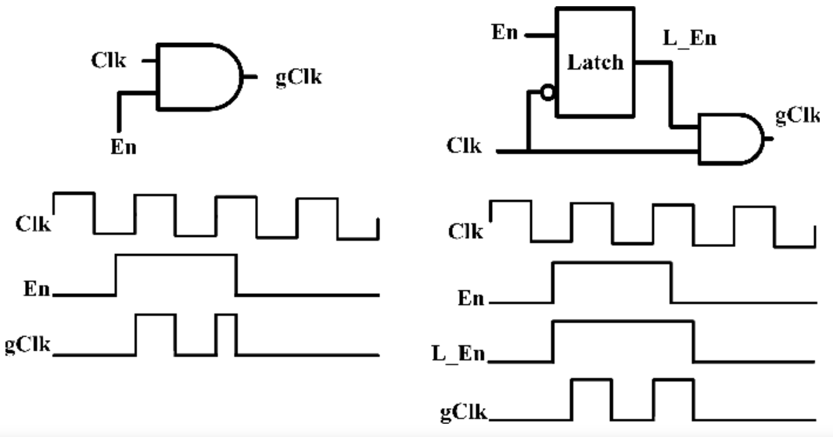
5.4 Guidelines for Clocks and Resets
Integrated Clock Gating (ICG) Cell

Slide 24
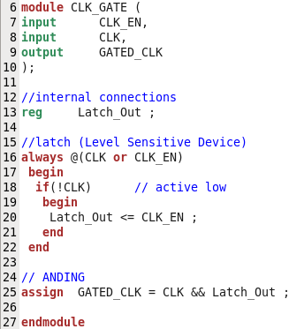
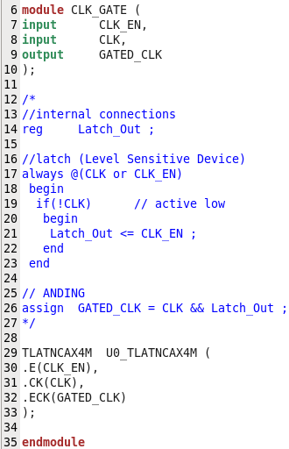
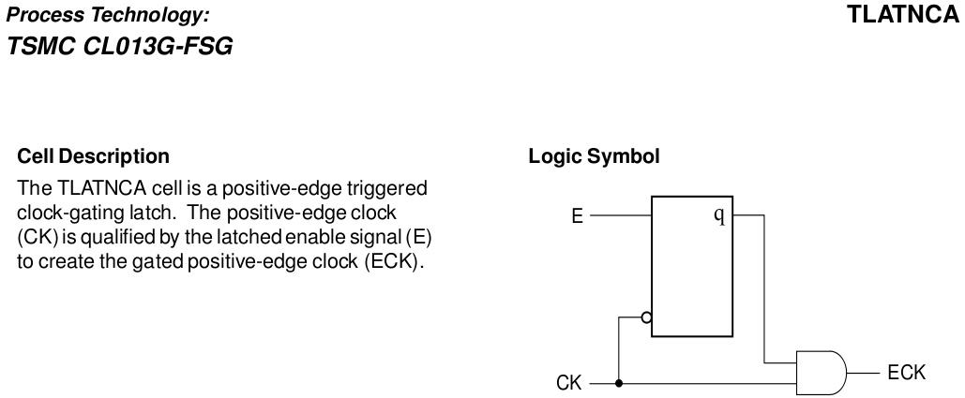
5.4 Guidelines for Clocks and Resets

Slide 25
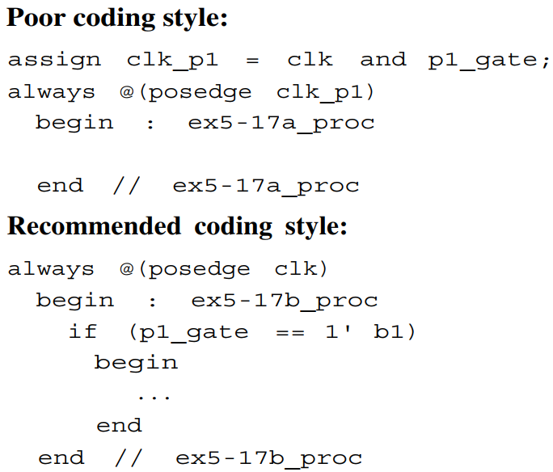
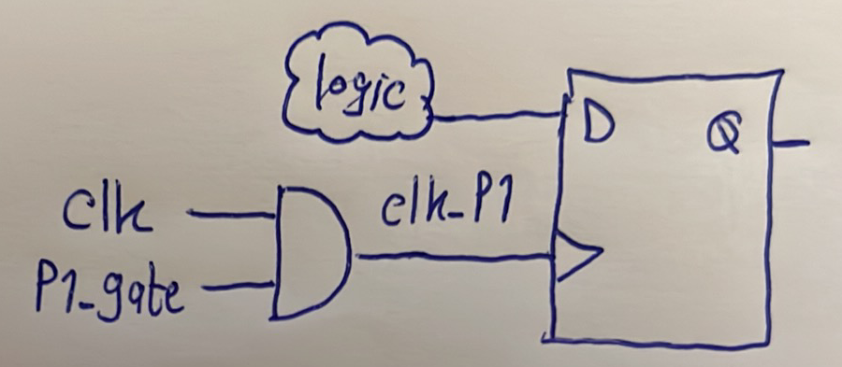
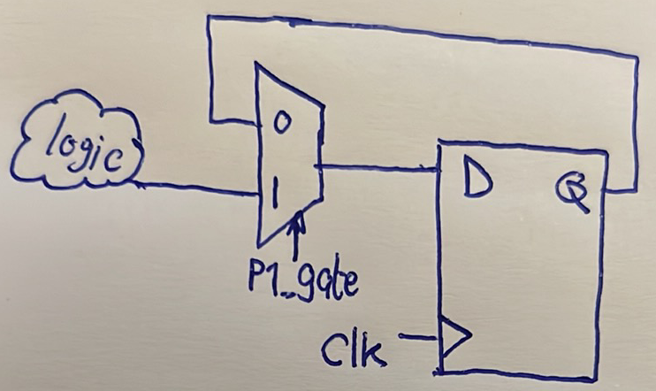
5.4 Guidelines for Clocks and Resets

Slide 26
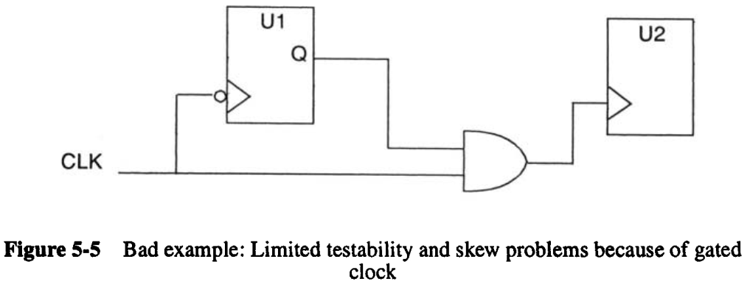
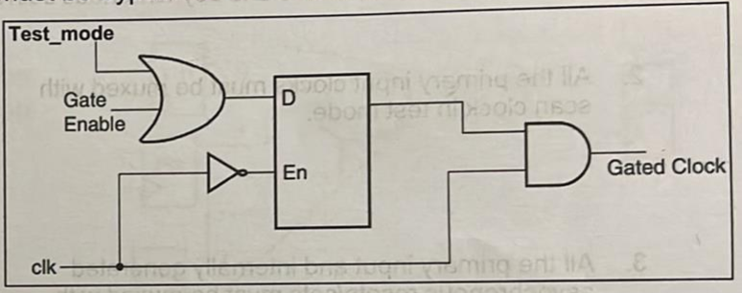
5.4 Guidelines for Clocks and Resets

Slide 27
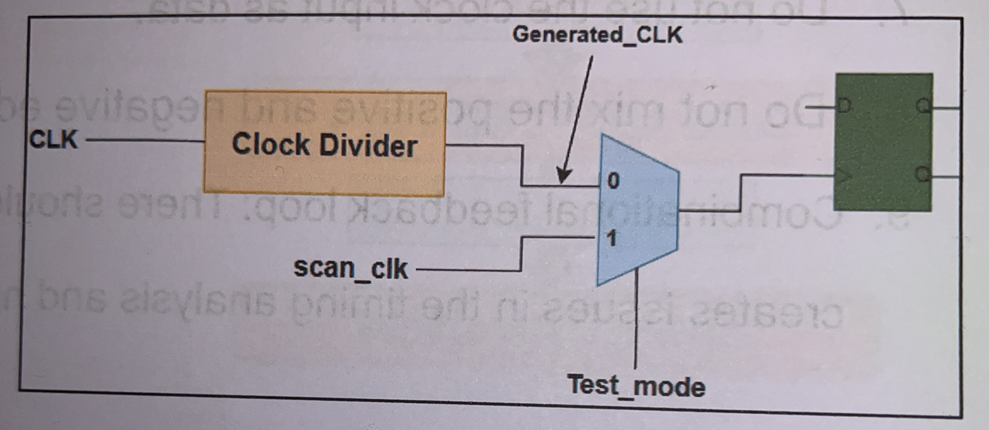
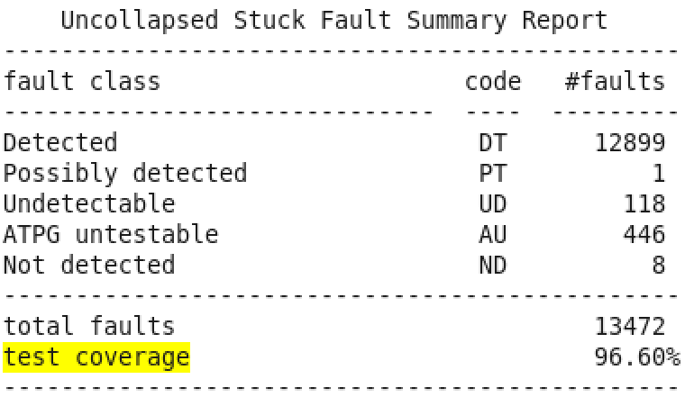
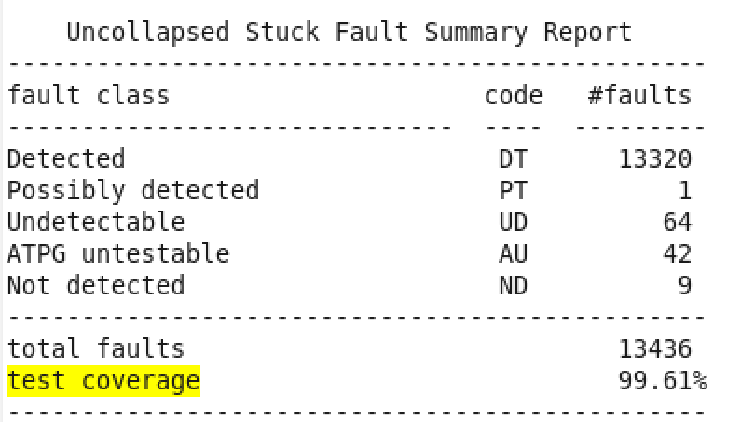
5.4 Guidelines for Clocks and Resets
5.4.4 Avoid Internally Generated Clocks
Guideline – Avoid using internally generated clocks in your design as they cause limited testability because logic driven by them cannot be made part of a scan chain.

Slide 28
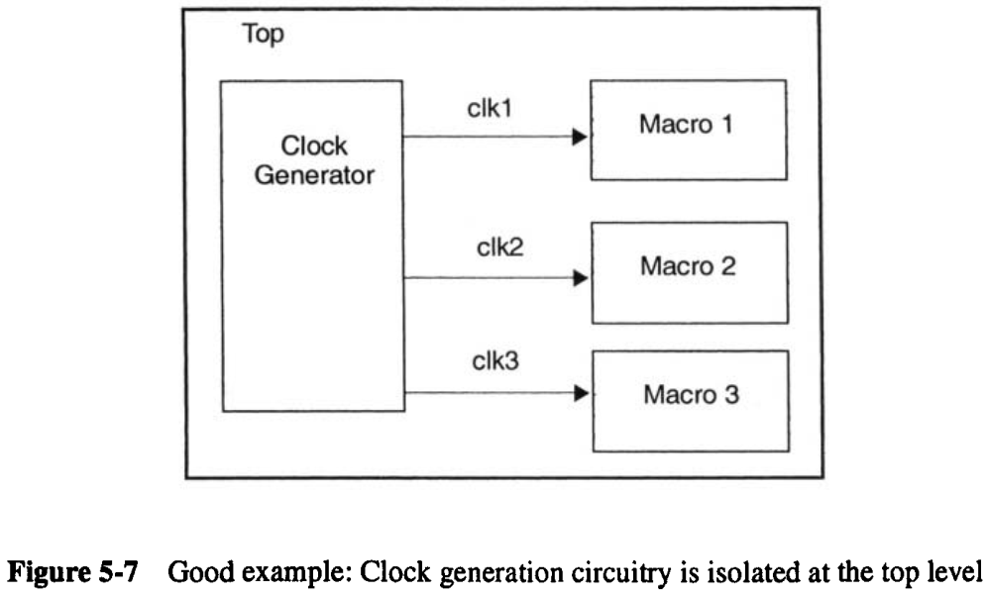
5.4 Guidelines for Clocks and Resets
5.4.5 Gated Clocks and Low-Power Designs
Guideline – keep the clock and/or reset generation circuitry as a separate module at the top level of the design.

Slide 29
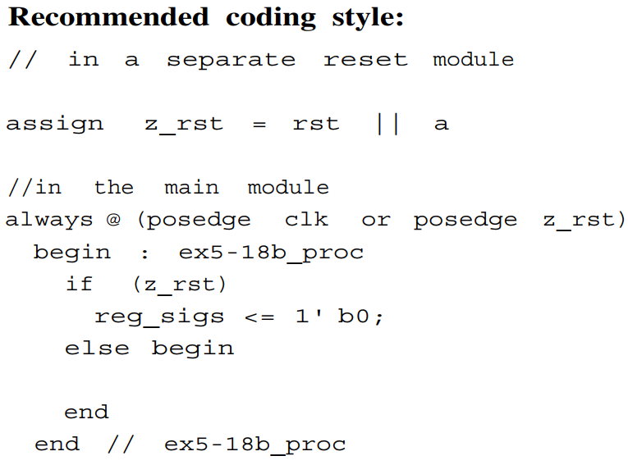
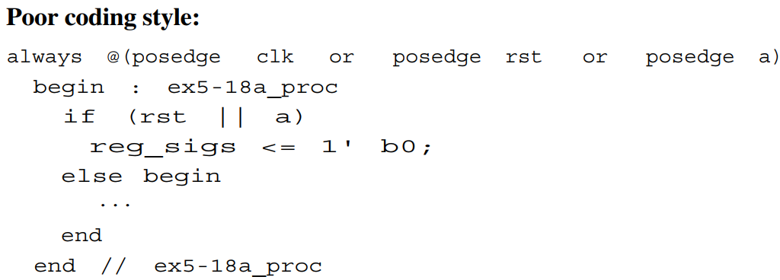
5.4 Guidelines for Clocks and Resets
5.4.6 Avoid Internally Generated Resets
Guideline – Avoid internally generated, conditional resets if possible. Generally, all the registers in the macro should be reset at the same time. If a conditional reset is required, create a separate signal for the reset signal, and isolate the conditional reset logic in a separate module.

Slide 30
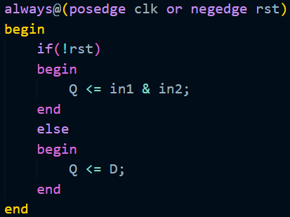
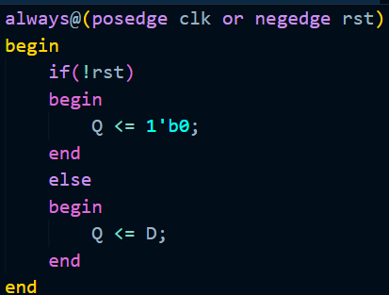
5.4 Guidelines for Clocks and Resets
5.4.7 Reset Logic Function
Guideline – The only logic function for the reset signal should be a direct clear of all flip-flops. Never use the reset inputs of a flop to implement state machine functionality. Reserving reset pins on flops for reset only makes it easier to generate buffer trees for resets.

Slide 31
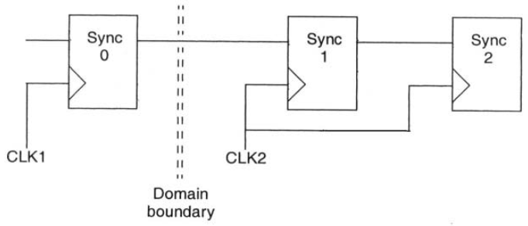
5.4 Guidelines for Clocks and Resets
5.4.8 Single-Bit Synchronizer
Guideline – Use two flip-flop stages to transfer single bits between clock domains. To prevent transfer of glitches, do not connect combinatorial logic from one clock domain to another.
5.4.9 Multi-Bit Synchronizers
Guideline – Do not use multiple copies of a single-bit synchronizer between domains. Instead, use a reliable handshake circuit or multibit coding scheme such as Gray code.

Slide 32
5.5 Coding for synthesis
The following guidelines aim to achieve The following :
– Performance . –Simplification for static timing analysis. –Gate Level behavior that matches the original RTL – Testability

Slide 33
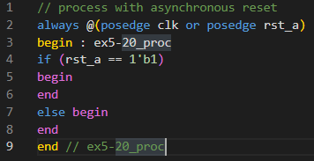
5.5 Coding for synthesis
5.5.1 Infer Registers
For Sequential Logic :
Guideline – Using flip-flops helps to achieve consistency of design . – For initializing The registered signal, -Use reset signal rather than using ‘Inital Statement’ As it causes mismatches between pre & post synthesis , It’s not synthesizible for ASIC flow , and sometimes Sometimes It’s synthesizible for FPGA flow tools (Ex. initializing memories)

Slide 34
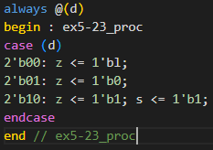
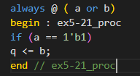
5.5 Coding for synthesis
5.5.2 Avoid Lathes
Rule – Avoid using any latches in your design [They are more susceptible to noise as they are level sensitive] Note – Use a design checking tool to check for latches in your design
All latches must be instantiated and you must provide documentation that
lists each latch and describes any special timing requirements that result from the
latch.
A latch is infered of missing else statement: | A latch is infered of assigments and conditions _case 2’b11_ .

Slide 35
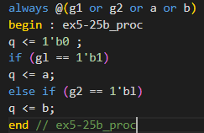
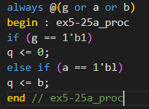
5.5 Coding for synthesis
5.5.2 Avoid Lathes
Avoiding Latches can be done as follows : 1)Assign default values at the beginning of combinational always_block . 2)Assign outputs for all input conditions . 3)Use else (instead of elsif) for the final priority branch .
Poor style of coding : Output is assigning output for all inputs coditions . | Recommended style : Output has a default value .

Slide 36
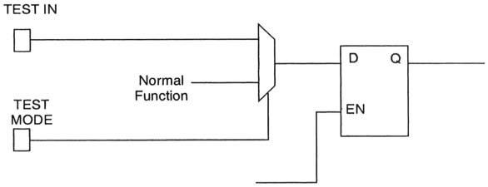
5.5 Coding for synthesis
5.5.3 If you must use Lathes
Rule – We can use latches for testability as follows since it’s not avoidable in this case . – This can be achieved by using a mux between the normal function and the test data to the mux. The selector can be an enable to test mode .

Slide 37
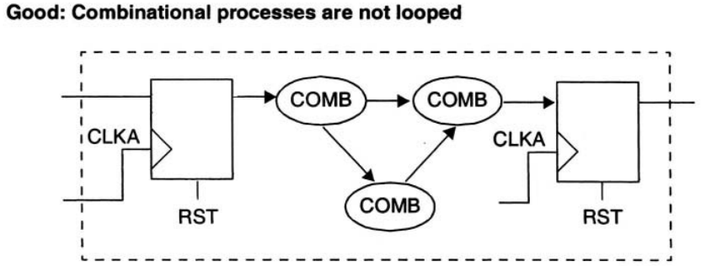
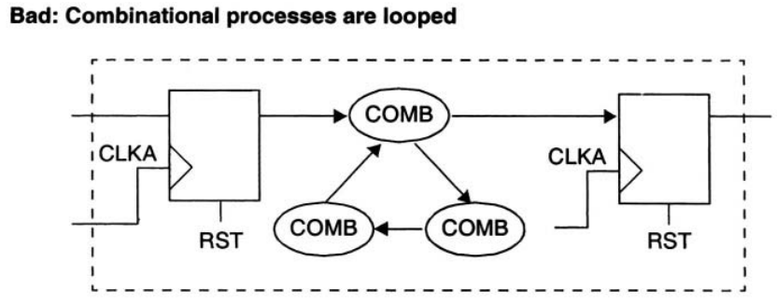
5.5 Coding for synthesis
5.5.4 Avoid Combinational Feedback
Guideline – Avoid using any Combinational looping in your design . As it makes STA very hard .
Instead of This combinational loop : | Break The loop into one forward direction with no feedback: v
Instead of This combinational loop : | Break The loop into one forward direction with no feedback: v

Slide 38
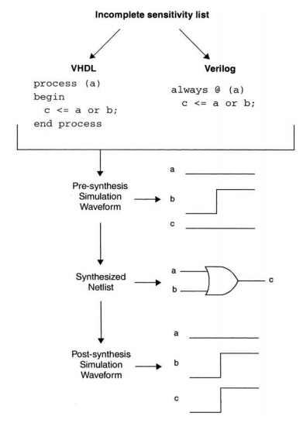
5.5 Coding for synthesis
5.5.5 Specify Complete Sensitivity Lists
Guideline – Rule – Include a complete sensitivity list in each always (Verilog) blocks To avoid mismatch between pre & post syntehsis .

Slide 39
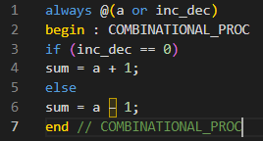
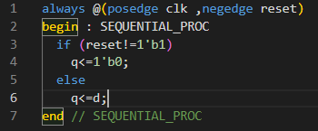
5.5 Coding for synthesis
5.5.5 Specify Complete Sensitivity Lists
Guideline – Only include the necessary signals in the sensitivity list ,As adding unnecessary signals to the sensitivity list slows down simulation , As the always can be unnecessarily retriggered many times .
Combinational block: Sensitivity list should : -Contain all read signals in the block That appears in the RHS or Conditions . -We can use always(*) to contain all read signals in the always block . | Sequential Block : Sensitivity list should : -Contain edge triggerd clock . -Incase of asynchrounous reset , Edge triggered reset must be included .

Slide 40
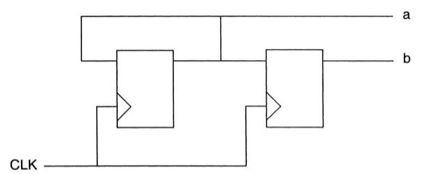
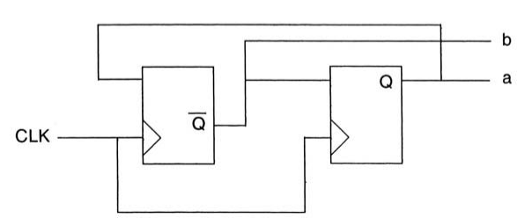
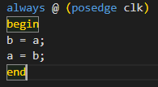
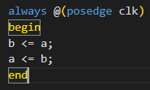
5.5 Coding for synthesis
5.5.6 Blocking and Nonblocking Assignments
Rule – When writing synthesizable code, always use nonblocking
assignments in always@ (posedge clk) blocks.
Blocking assignment : Execution is done sequentially (line by line ). So in the following example , - a is assigned to b . - a is assigned to b which already has the value of a . so a just loops around and is reassigned every clock. | Non_blocking assignment: Execution is done concurrently (RH sides are evaluated then assigned to LH sides each clock ) and that’s the intended behaviour .

Slide 41
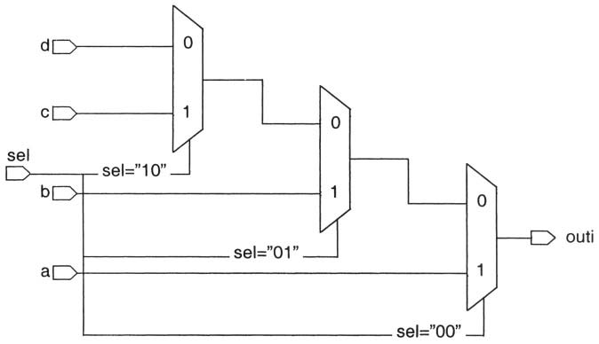
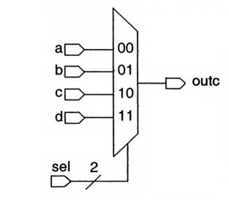
5.5 Coding for synthesis
5.5.8 Case Statements vs. if-then-else Statements: Guideline – The multiplexer is a faster circuit. So, if the priority-encoding structure is not required, case statement is prefered over if-else statement . - Note _ An if-then-else statement can be useful if you have a late-arriving signal like the shown example , if ‘a’ is a late arriving signal , it can be connected to the fastest path (first if condition )
Case Statement : | If -else statements : v

Slide 42
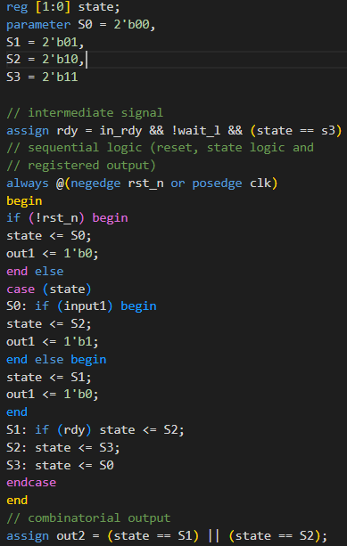
5.5 Coding for synthesis
5.5.9 Coding Sequential Logic: Guideline _ Code sequential logic, including state machines, with one sequential
sequential process. Improve readability by generating complex intermediate variables
outside of the sequential process with assign statements. Guideline – Keep FSM and non-FSM logic in separate modules if they have different synthesis requirements. For example, a very complex FSM might need to be in a separate module from a complex arithmetic block.

Slide 43
5.5 Coding for synthesis
5.5.10 Coding Sequential Logic: Guideline _ Guideline – Keep late-arriving signals with critical timing closest to the output of a
logic block. For example, use the late-arriving signal early in an if-else block (first if condition in if-else statements) ----------------------------------------------------------------------------------- 5.5.11 Avoid Delay Times: Guideline – Do not use any delay constants in RTL code for the following reasons : 1) Delays aren’t synthesizable . 2) They may may cause simulation behavior to differ from synthesis results. Instead , 1) Use Non_blocking assignments in your sequential designs 2)Adjust clock timing to your RTL and the interface timing from and to your code. ----------------------------------------------------------------------------------- 5.5.12 Avoid full_case and parallel_case Pragmas : Guideline (Verilog only) –Write Verilog case statements to cover all cases with no overlap. Do not use the full_case or parallel_case pragmas, because these cause a difference in code interpretation between synthesis and simulation. "full_case" removes latches from the design.
• "parallel_case" removes large, slow priority encoders from my designs.

Slide 44
5.6 Partitioning for Synthesis
– The aim for good partitioning of the design is the following : -Better synthesis results
-Faster compile runtimes
-Ability to use simpler synthesis strategies to meet timing

Slide 45

5.6 Partitioning for Synthesis
5.6.1 Register All Outputs
Guideline – For each subblock of a hierarchical macro design, register all output
signals from the subblock for the following benefits : As This Simplifies the synthesis process: 1) It makes output drive strengths and input delays predictable. [Reg2out path type] 2) All the inputs of each block arrive with the same relative delay.

Slide 46



5.6 Partitioning for Synthesis
5.6.2 Locate Related Combinational Logic in a Single Module
Guideline – Keep related combinational logic together in the same module. Because : 1)The synthesis tools have flexibility to optimize logic within The module itself yet can’t optimize beyond this as it maintains hierarchical boundaries in the design between different modules . 2)This eases time budgeting between blocks and allows for faster simulation.
Guideline – It’s best to group all related logic to the destination block . This helps to in timing optimization .

Slide 47

5.6 Partitioning for Synthesis
5.6.3 Separate Modules That Have Different Design Goals
As shown the following example: It shows a design where the critical path logic is grouped into a separate module from the noncritical path logic . _ This differntiates the behaviour of the synthesis tool for both modules optimization : Module A: Speed optimization is needed . Module B: Area optimization is needed .

Slide 48
5.6 Partitioning for Synthesis
5.6.4 Asynchronous Logic Guideline – Avoid asynchronous logic for the following reasons :
1)Asynchronous logic is more difficult to design correctly and verify. 2)Correct timing and functionality may be technology dependent, which limits the portability of the design.
Guideline – If asynchronous logic is required in the design, partition the asynchronous logic in a separate module from the synchronous logic:
1) Isolating the asynchronous logic in a separate module makes code inspection much
easier. 2)Asynchronous logic needs to be reviewed carefully to verify its functionality
and timing.

Slide 49



5.6 Partitioning for Synthesis
5.6.5 Arithmetic Operators: Merging Resources
As we see in this example :That normally two adder are to be created , Yet The synthesis tool will more likely to synthesize one adder to be shared in two additions which is called (Merging Resources)
Poor way of partitioning the operators that can be shared by hierarchically seperating them into differernt modules. | Recommended way of partitioning the operators that can be shared by combining them into the same hierarchy .

Slide 50
5.6 Partitioning for Synthesis
5.6.6 Partitioning for Synthesis Runtime Guideline – The most important considerations in partitioning should be the logic function, design goals, and timing and area requirements to optimize the runtime of synthesis process this can be done as follows : 1)Grouping related functions together is much better than splitting functions artificially. 2)Good timing budgets and appropriate constraints can have a larger impact on
synthesis runtime than circuit size does. 3) Grouping logic according to design goals [Area _Timing or both ], the synthesis strategy can be focused, reducing synthesis runtime.

Slide 51

5.6 Partitioning for Synthesis
5.6.7 Avoid Timing Exceptions Timing Exceptions : Those are the pathes that doesn’t require the data to be transfered withing one clock . -False paths : Timing path’s not required to meet its timing constraints for the design to function properly . for the STA tools they maybe identified as failling paths yet the designer knows they aren’t failling .
-Multicylce paths : Design tools including synthesis, static timing analysis, and place and route tools must allow the data to take more than one clock cycle to traverse the path
Guideline – Avoid multicycle paths and other timing exceptions in your design.

Slide 52


5.6 Partitioning for Synthesis
5.6.7 Avoid Timing Exceptions Guideline – If you must use timing exceptions in your design, use start and end points which are guaranteed to exist and be valid at the chip level.
False Paths | MultiCycle paths
Guideline – Avoid false paths in your design. As the designer may accidentally ignore a valid warning of a time failling path . | Use Isolating point-to-point exceptions as shown in the following example . A multicylce path is defined between D_reg to S_reg This improves synthesis and timing results .

Slide 53


5.6 Partitioning for Synthesis
5.6.8 Eliminate Glue Logic at the Top Level
Guideline – Do not instantiate gate-level logic at the top level of the macro hierarchy.
We can in the following example that : Optimization is limited because synthesis
tools cannot merge the NAND with the combinational logic inside Block C.
This eleminates any extra effort to compile any glue logic at the top level .

Slide 54

5.6 Partitioning for Synthesis
5.6.9 Chip-Level Partitioning **********
Guideline – Make sure that the top level of the design contains only : 1)the I/O pad ring 2)clock generator. - The next level of hierarchy contains IEEE 1149.1 boundary scan (JTAG) modules and the core logic. The clock generation circuitry is isolated from the rest of the design as it is normally hand crafted and carefully simulated.

Slide 55

5.7 Designing with Memories
Guideline – Keep memory interface pins at the top level of a macro cell to allow user choice of memory implementation, interface, and test.
Note _ Synchronous Rams are the only reliable memories for SoC because asynchronous memories have problems generating write enable pulses since it’s not associated with the system clock . Plus Synchrounous Rams are faster than asynchrounous ones . yet they need more complex interfaces.

Slide 56
5.8 Code Profiling
Guideline – code profiling can assist you in optimizing your code for simulation speed .
Note _Tracking how often each line of code is executed during a given simulation run can reveal bottleneck areas in the model .

